Slide 1
Network Programming Project-1 Reliable file transfer using Go-Back-N protocol
Pimenov Gleb 1820243077
Notes:
You can check notes instead of voice guidance

Slide 2
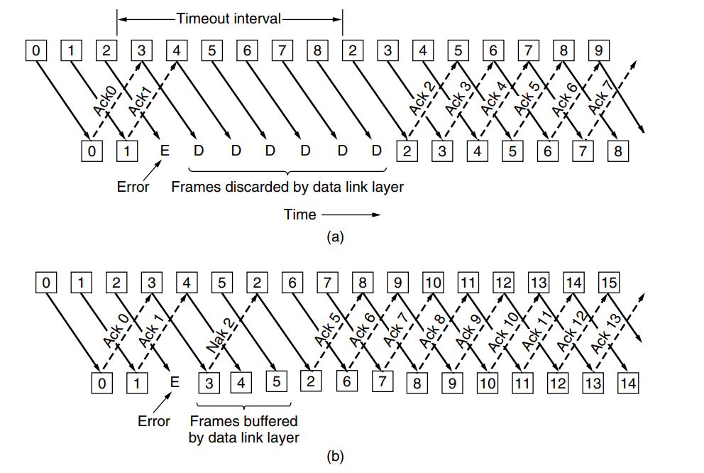
Go Back N protocol
Notes:
The project requires the development of a software client that can send files using the go back n protocol. The program must convert a file into packets for sending and build a file from the received packets. The program must use only UDP. The maximum packet size is 4KB. The GBN protocol implemented shall support full duplex. The program must be able to generate sending errors when sending. The program must send files of any size, for testing it is recommended to use files more than 3MB. The program should be configurable by the user. The program should keep logs.
GBN is reliable for file transfers because if the user is not sure whether the packet has been received, the algorithm repeats sending until it is sure of receipt. The protocol also makes efficient use of time.
The go back n protocol is a sliding window protocol used in network communication for reliable data transmission. It allows a sender to transmit multiple frames before receiving an acknowledgment from the receiver. If an acknowledgment is not received within a specified time frame, the sender retransmits all unacknowledged frames starting from the last acknowledged one.

Slide 3
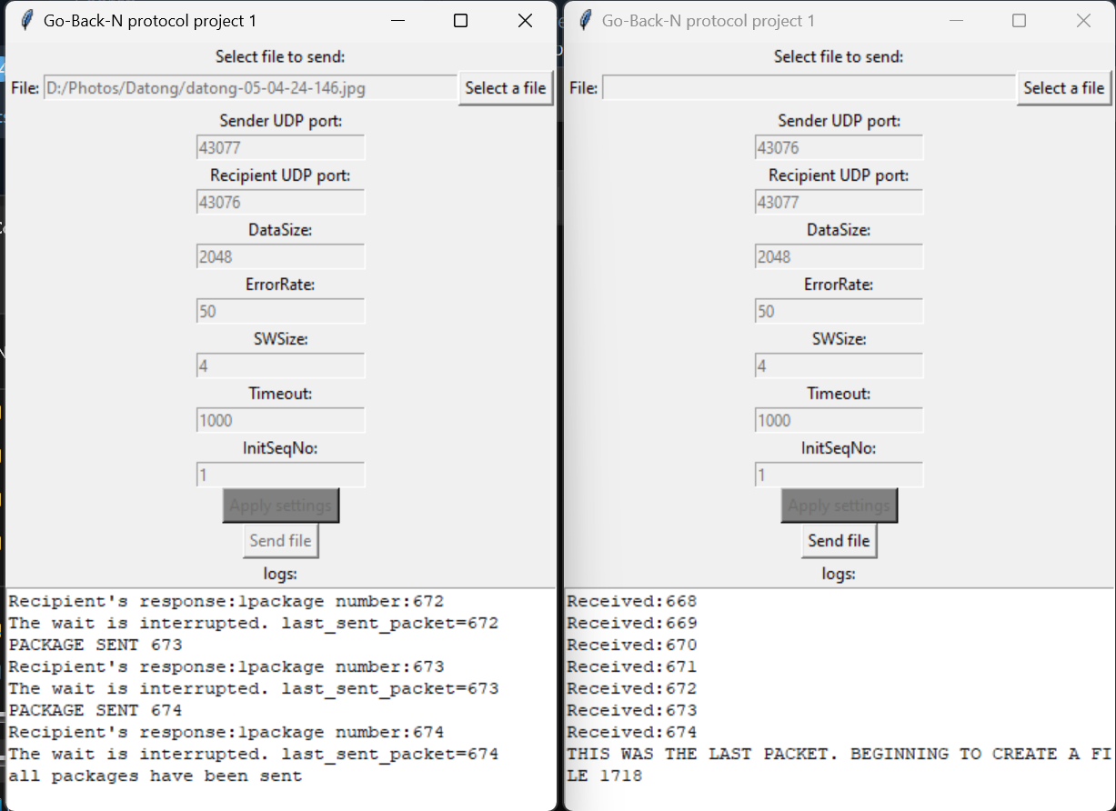
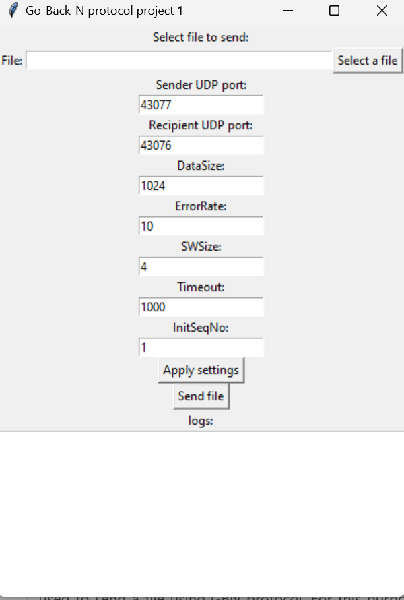
The application
Notes:
The program is an application with a graphical interface in which it is possible to set parameters and track program activity in the log
python programming language is chosen for development because the team has more experience with this language. Version python 3.11.7. OS windows 10/11.
Send and receive file has one source code. Runs 2 iterations of the program, specifies the port of the sender and recipient.
Inside the program contains 2 classes Sender and Receiver. These classes are responsible for sending and receiving data via UDP. Sender class is used to send a file using GBN protocol. For this purpose it has a method send_data(self,data). As input it receives an array of packets into which the file was converted for sending (the file is divided into packets when the Send file button is pressed). Also Sender class has auxiliary methods responsible for timer management.
The Receiver class is executed in parallel from the moment the configuration settings are applied. The class waits for receiving packets and determines their type. If the packet is a part of a file, then the packet will be processed as a part of the file, namely: the data (number, crc, data) will be extracted, the crc32 hash sum for the data will be calculated, and a data integrity response will be sent. If the packet is a response from the recipient, the need to return to the N.
After pressing the Send file button, this happens:
Packets to be sent are generated. The number starting from the number specified in the configuration is set. The crc part of data is calculated.
The send_data procedure is started in parallel mode.
the range of working indexes is defined (from InitSeqNo - to data_chunks_count + InitSeqNo).
Packet sending cycle starts.
Working with sanding window.
Checking the return to N.
Sending a packet.
Starting the timer.
Checking the end of the timer (runs in parallel).

Slide 4
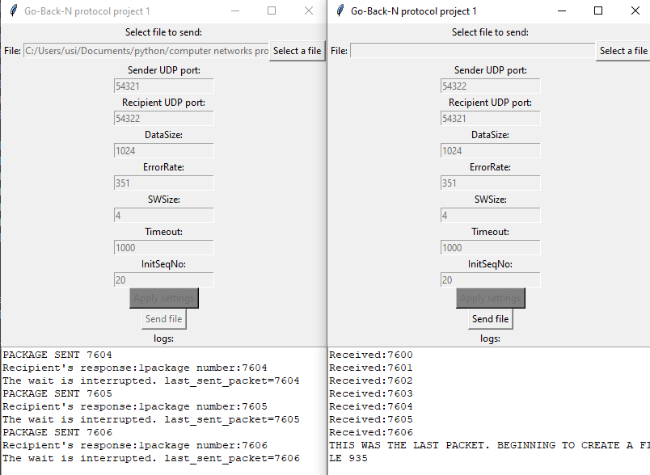
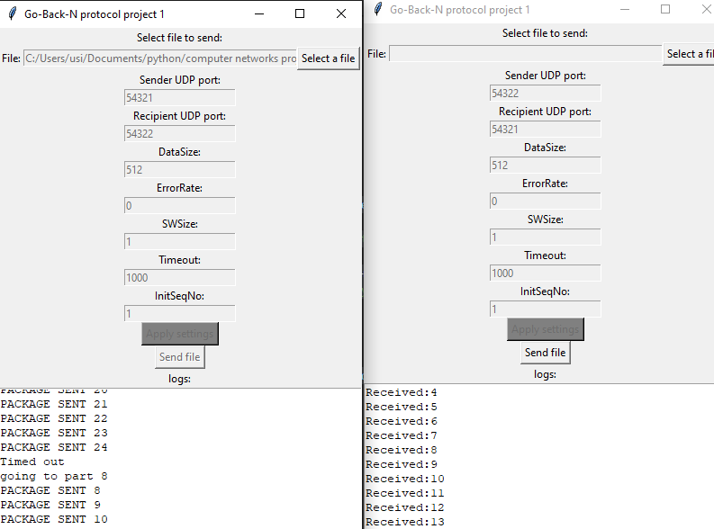
Testing
Notes:
Possible cases:
sending without errors/ with errors.
window size 1 / larger 1.
packet fails to timeout.

Slide 5
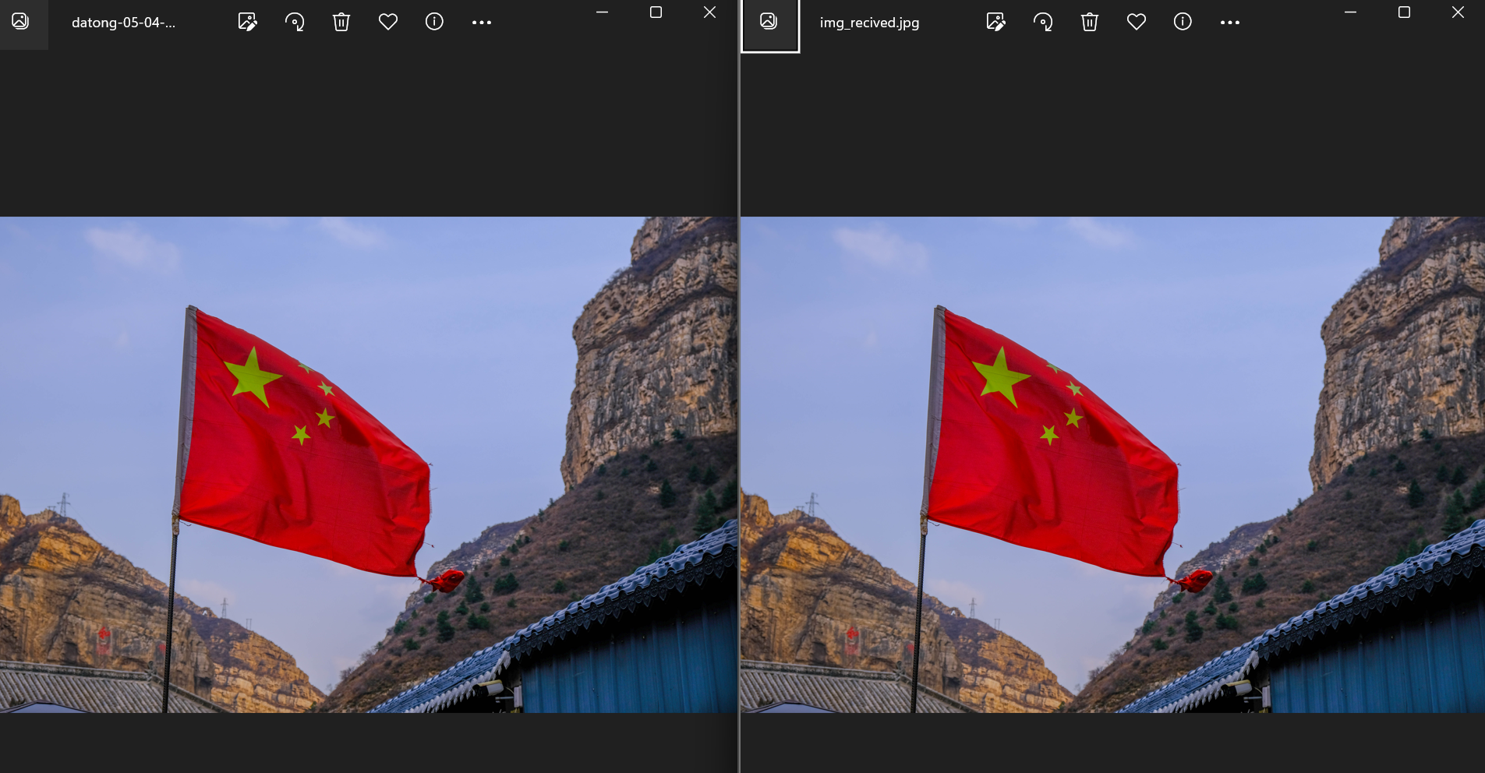
Testing
Notes:
In this slide you can see original and received image – proof that program sends files correctly

